Slide 1
Lab Seminar
2024.11.19
16:00(UTC+9)
Seungwan Woo (UST)

Slide 2
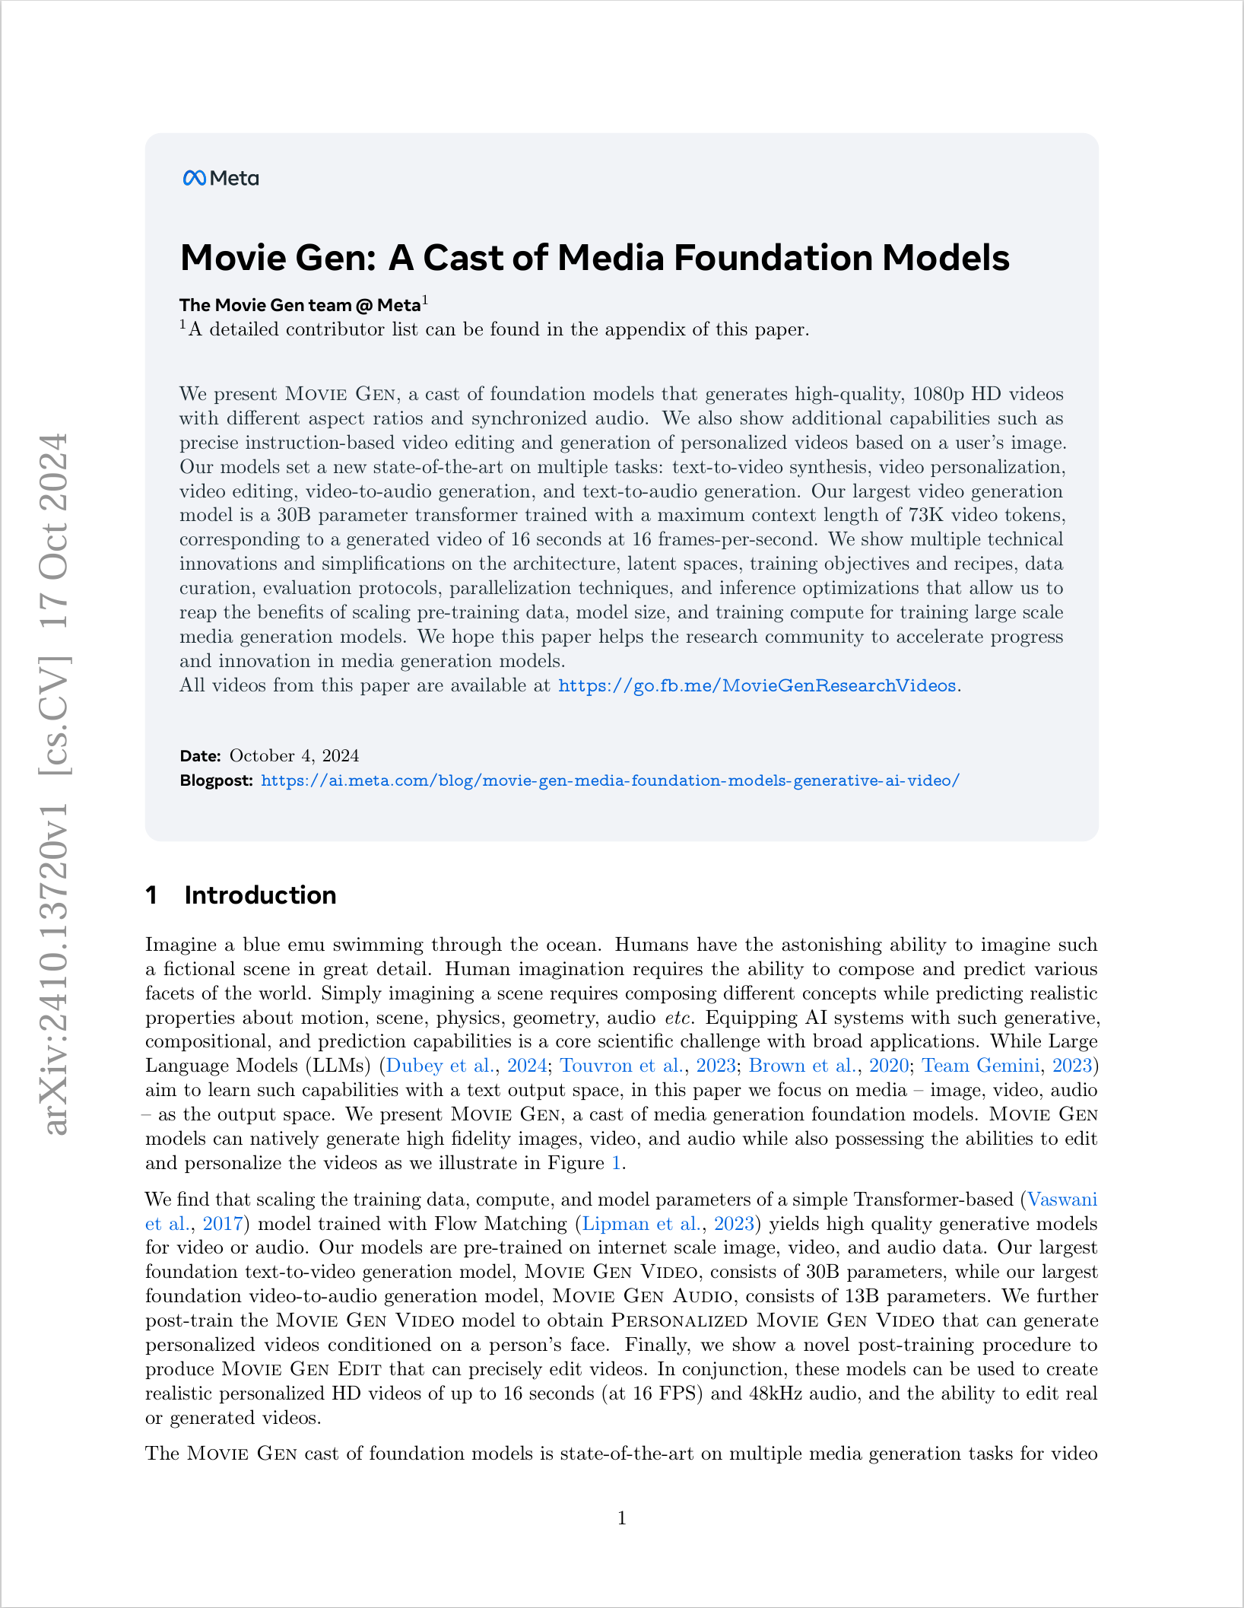
Movie Gen: A Cast of Media Foundation Models
Meta
The Movie Gen team

Slide 3
Polyak, Adam, et al. "Movie gen: A cast of media foundation models." arXiv preprint arXiv:2410.13720 (2024).
Introduction
Imagine a blue emu swimming through the ocean.
Human imagination requires the ability to compose and predict various facets of the world. Simply imagining a scene requires composing different concepts while predicting realistic properties about motion, scene, physics, geometry, audio etc.
Equipping AI systems with such generative, compositional, and prediction capabilities is a core scientific challenge with broad applications.

Slide 4
Polyak, Adam, et al. "Movie gen: A cast of media foundation models." arXiv preprint arXiv:2410.13720 (2024).
Introduction
Large Language Models (LLMs) aim to learn such capabilities with a text output space.
In this paper focus on media– image, video, audio– as the output space.
Movie Gen models can natively generate high fidelity images, video, and audio while also possessing the abilities to edit and personalize the videos.
Authors find that scaling the training data, compute, and model parameters of a simple Transformer-based model trained with Flow Matching yields high quality generative models for video or audio.

Slide 5
Polyak, Adam, et al. "Movie gen: A cast of media foundation models." arXiv preprint arXiv:2410.13720 (2024).
Introduction
Consist of
Movie Gen Video: Largest foundation Text-to-Video generation model
Personalized Movie Gen Video
Movie Gen Audio: Largest foundation Video-to-audio generation model
Movie Gen Edit: precisely edit videos

Slide 6
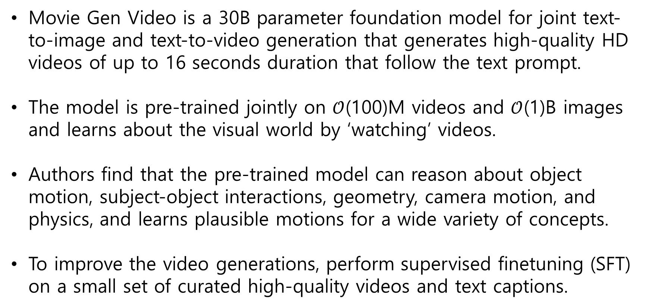
Polyak, Adam, et al. "Movie gen: A cast of media foundation models." arXiv preprint arXiv:2410.13720 (2024).
Movie Gen Video – Overview
Movie Gen Video is a 30B parameter foundation model for joint text-to-image and text-to-video generation that generates high-quality HD videos of up to 16 seconds duration that follow the text prompt.
The model is pre-trained jointly on $𝒪$(100)M videos and $𝒪$(1)B images and learns about the visual world by ‘watching’ videos.
Authors find that the pre-trained model can reason about object motion, subject-object interactions, geometry, camera motion, and physics, and learns plausible motions for a wide variety of concepts.
To improve the video generations, perform supervised finetuning (SFT) on a small set of curated high-quality videos and text captions.

Slide 7
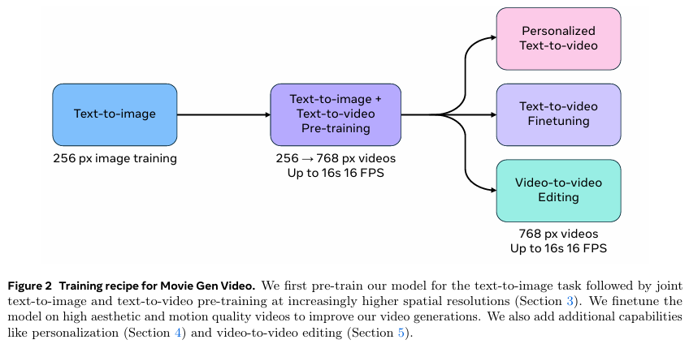
Polyak, Adam, et al. "Movie gen: A cast of media foundation models." arXiv preprint arXiv:2410.13720 (2024).
Movie Gen Video – Joint Image and Video Generation
Pretrain only on low-resolution 256 px images followed by joint pre-training on low-resolution images and videos, and high-resolution joint training.
Finetuning the model on high quality videos to improve the generations.
Add capabilities such as personalization and editing by post-training.

Slide 8
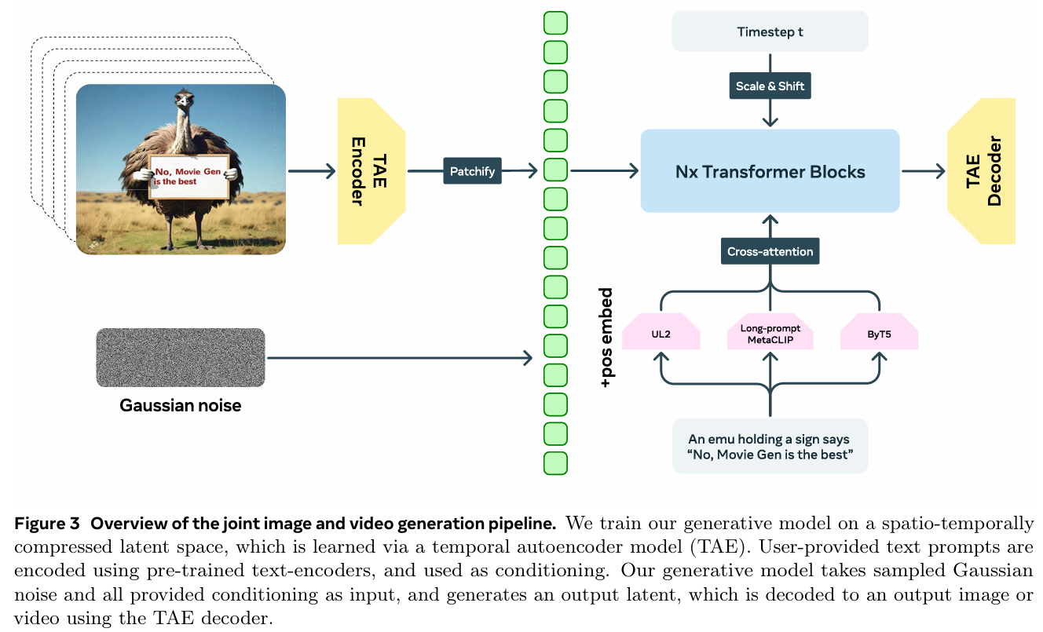
Polyak, Adam, et al. "Movie gen: A cast of media foundation models." arXiv preprint arXiv:2410.13720 (2024).
Movie Gen Video – Joint Image and Video Generation

Slide 9
Polyak, Adam, et al. "Movie gen: A cast of media foundation models." arXiv preprint arXiv:2410.13720 (2024).
Movie Gen Video – Joint Image and Video Generation
Authors focus on simplicity when making design choices for all components in our foundation model, including the training objective, backbone architecture, and spatio-temporal compression using the TAE.
Largest 30B parameter model can directly generate video at different aspect ratios (e.g., 1:1, 9:16, 16:9), of multiple lengths (4– 16 seconds) at 768 × 768 px resolution (scaled appropriately based on the aspect ratio).
Spatial Upsampler can further increase the spatial resolution to produce a video in full HD 1080p resolution.

Slide 10
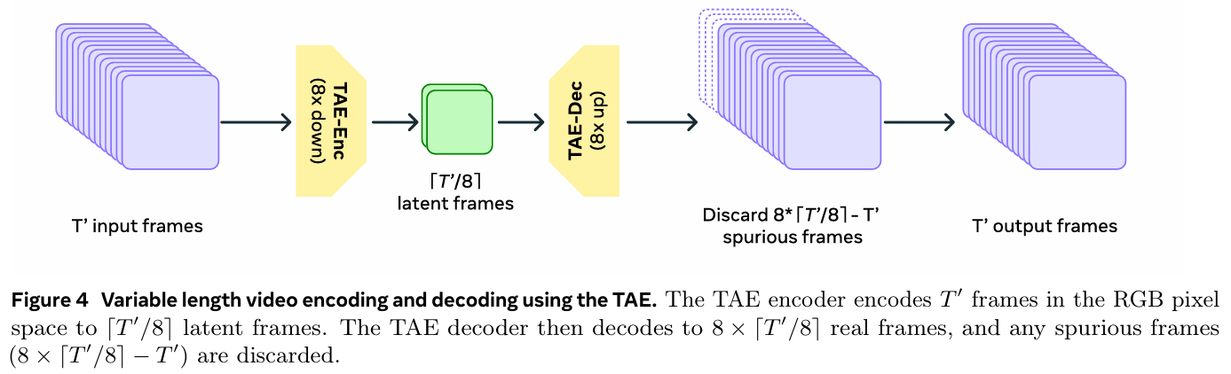
Polyak, Adam, et al. "Movie gen: A cast of media foundation models." arXiv preprint arXiv:2410.13720 (2024).
Movie Gen Video – Joint Image and Video Generation
Temporal Autoencoder (TAE)
Compresses the input pixel space video V (T’ x 3 x H’ x W’) to a continuous valued latent X (T x C x H x W)
T′/T = H’/H = W′/ W = 8,
C(Number of channels in the latent space X) = 16
Temporal downsampling is performed via strided convolution with stride of 2, and upsampling by nearest-neighbour interpolation followed by convolution.
This process removes spurious frames and makes the frames flow more naturally.

Slide 11
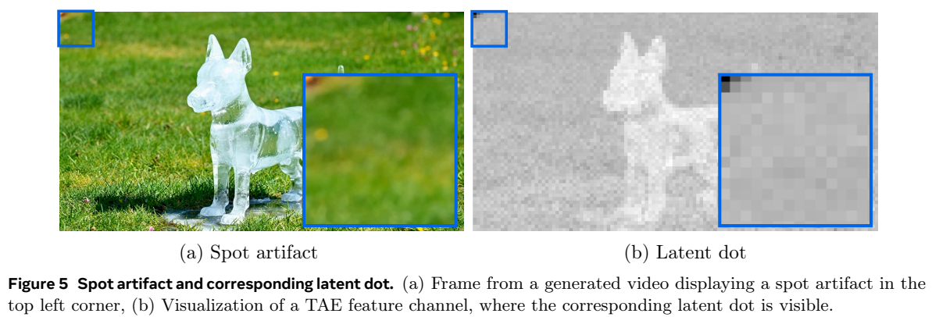
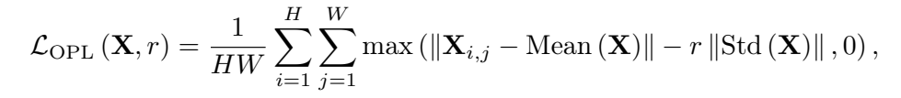
Polyak, Adam, et al. "Movie gen: A cast of media foundation models." arXiv preprint arXiv:2410.13720 (2024).
Movie Gen Video – Joint Image and Video Generation
Improvements to the training objective
Standard methods, such as LDM, generate high-norms at specific locations in the latent space, which appear as spot artifacts during decoding.
This is a form of shortcut learning, where the model learns to store crucial global information in these high-norm latent dots.
In this paper, prevent high-norms by penalizing high-norm values that deviate significantly from the latent space mean without changing the model structure.
r=3 , loss weight: 1e5

Slide 12
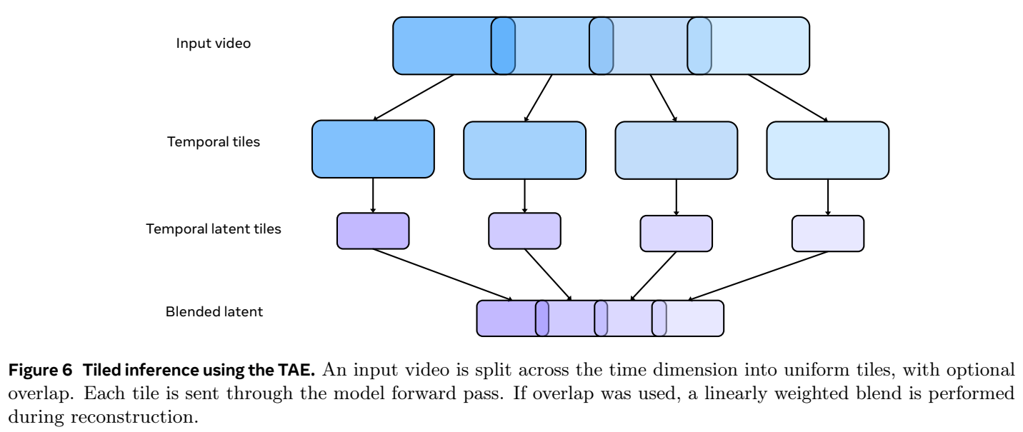
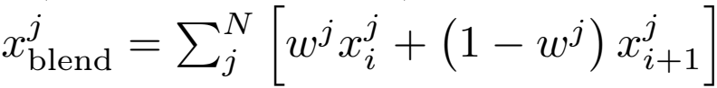
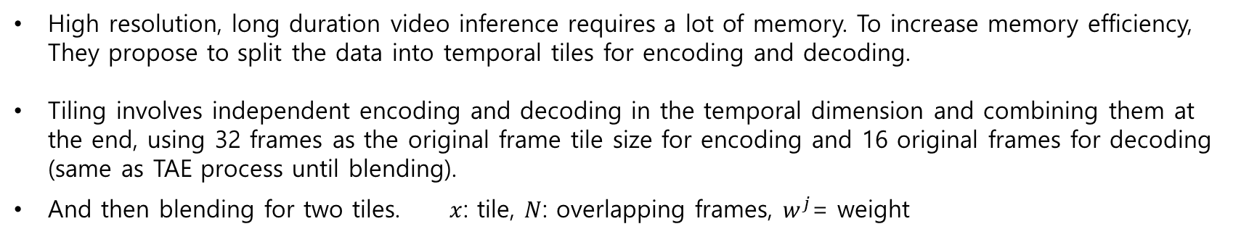
Polyak, Adam, et al. "Movie gen: A cast of media foundation models." arXiv preprint arXiv:2410.13720 (2024).
Movie Gen Video – Joint Image and Video Generation
Efficient inference using temporal tiling
High resolution, long duration video inference requires a lot of memory. To increase memory efficiency, They propose to split the data into temporal tiles for encoding and decoding.
Tiling involves independent encoding and decoding in the temporal dimension and combining them at the end, using 32 frames as the original frame tile size for encoding and 16 original frames for decoding (same as TAE process until blending).
And then blending for two tiles. $x$: tile, $N$: overlapping frames, $w^{j}$= weight

Slide 13
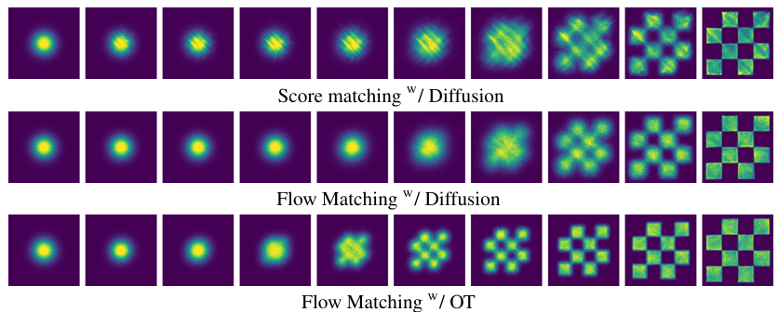
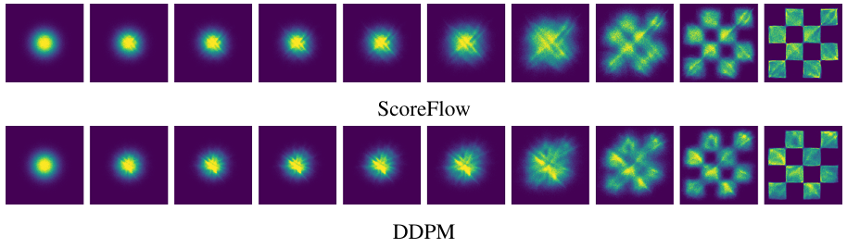
Polyak, Adam, et al. "Movie gen: A cast of media foundation models." arXiv preprint arXiv:2410.13720 (2024).
Movie Gen Video – Joint Image and Video Generation
Training Objective for Video and Image Generation

Slide 14
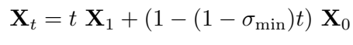
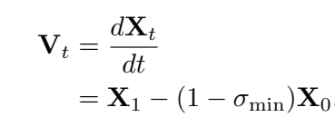
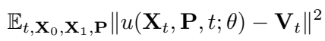
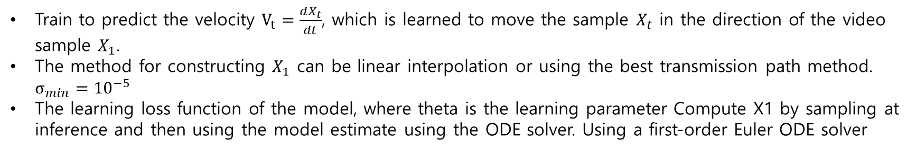
Polyak, Adam, et al. "Movie gen: A cast of media foundation models." arXiv preprint arXiv:2410.13720 (2024).
Movie Gen Video – Joint Image and Video Generation
Training Objective for Video and Image Generation
Generate samples from the target data distribution by iteratively changing samples from a prior distribution, such as a Gaussian, to generate samples from the target data distribution.
In training, given a video sample in the latent space $X_{1}$, sample a time step t and noise samples $X_{0}\sim 𝒩(0,1)$, and use them to construct a training sample $X_{t}$.
Train to predict the velocity $V_{t}=\frac{dX_{t}}{dt}$, which is learned to move the sample $X_{t}$ in the direction of the video sample $X_{1}$.
The method for constructing $X_{1}$ can be linear interpolation or using the best transmission path method. $σ_{min}={10}^{−5}$
The learning loss function of the model, where theta is the learning parameter Compute X1 by sampling at inference and then using the model estimate using the ODE solver. Using a first-order Euler ODE solver

Slide 15
Polyak, Adam, et al. "Movie gen: A cast of media foundation models." arXiv preprint arXiv:2410.13720 (2024).
Movie Gen Video – Joint Image and Video Generation
Training Objective for Video and Image Generation
The time step t controls the signal-to-noise ratio SNR, and the simple interpolation scheme for constructing Xt ensures zero SNR when t=0.
This allows the model to be trained to receive pure Gaussian noise samples during training to predict velocity.
During inference, if the model receives pure Gaussian noise at t=0, it can make reasonable predictions.
Most video models use diffusion. Recent studies have shown that choosing the right diffusion noise schedule with a terminal SNR of zero is crucial for video generation.
Standard diffusion noise schedules do not guarantee zero terminal SNR and must be modified for video generation purposes.
Since implementing flow matching naturally guarantees zero terminal SNR, Authors have found empirically that flow matching is more robust and performs better. So They use flow matching for simplicity and high performance.

Slide 16
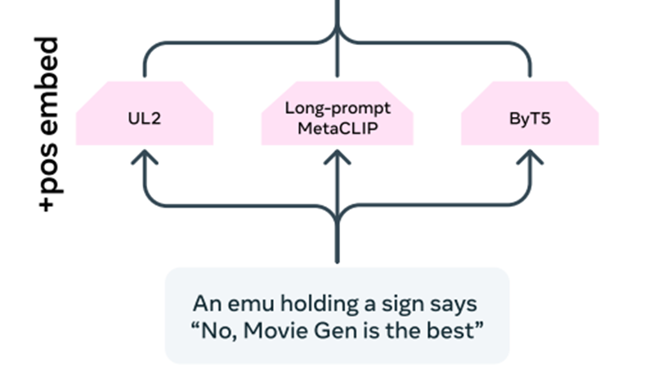
Polyak, Adam, et al. "Movie gen: A cast of media foundation models." arXiv preprint arXiv:2410.13720 (2024).
Movie Gen Video – Joint Image and Video Generation
Rich Text Embeddings and Visual-text Generation
UL2: trained on text alone, providing strong text inference capabilities
Long-prompt MetaCLIP: Alignment between visual and textual representations favors cross-modal generation, and is fine-tuned to handle long text captions.
ByT5: Provides character-level text encoding specialized for visual text.
Combining three text encoders to convert input text prompt p into test embedding P
Concatenates text embeddings from the three encoders into a single sequence by normalizing them to the same 6144-dimensional space via linear projection and LayerNorm
Pre-add FPS values to text prompts (e.g., “FPS-16”) for frame count adjustment during video creation
Control video length by sampling at the original FPS when pretraining, and at two fixed values of 16 FPS and 24 FPS when fine-tuning.

Slide 17
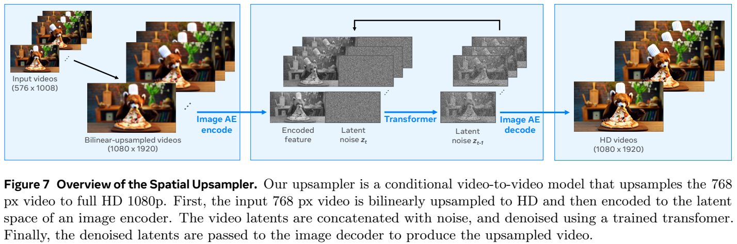
Polyak, Adam, et al. "Movie gen: A cast of media foundation models." arXiv preprint arXiv:2410.13720 (2024).
Movie Gen Video – Joint Image and Video Generation
Spatial Upsampling
Converting 768-pixel video to full HD resolution using a separate spatial upsampler model.
Generate an HD output video from a low-resolution input video by using a video-to-video generation operation.
The low-resolution video is spatially upsampled to the desired output resolution using bilinear interpolation in pixel space.
The video is then converted to latent space using VAEs. The upsampler uses frame-by-frame VAEs to improve pixel sharpness. Finally, the latent space model generates a latent of the HD video conditional on the latent of the corresponding low-resolution video.
The generated HD video latent space is then decoded into pixel space on a frame-by-frame basis using a VAE decoder.

Slide 18
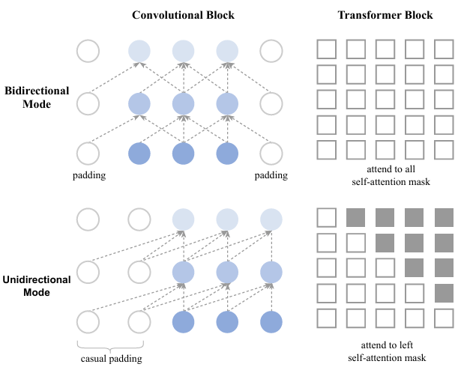
Polyak, Adam, et al. "Movie gen: A cast of media foundation models." arXiv preprint arXiv:2410.13720 (2024).
Movie Gen Video – Joint Image and Video Generation
Model Scaling and Training Efficiency
Using 6,144 H100 GPUs to train models.
LLM uses Causal Attention, but Movie Gen uses Bidirectional Attention to address the complexity of video. (detailed architecture is left for future work)

Slide 19
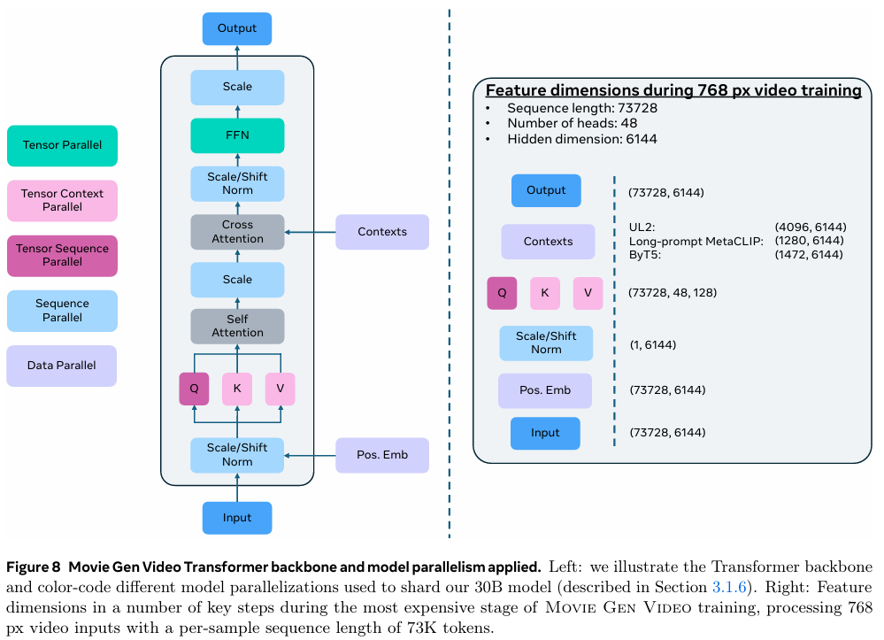
Polyak, Adam, et al. "Movie gen: A cast of media foundation models." arXiv preprint arXiv:2410.13720 (2024).
Movie Gen Video – Joint Image and Video Generation
Model Scaling and Training Efficiency
TP: Distributes the computation by dividing the weights of the model across multiple GPUs.
SP: Split input sequences (video clips) across multiple GPUs to process in parallel
CP: Saves memory by sharing only Q,K,V, and only K,V of self-attentio between GPUs to save memory
FSDP: Store model parameters, optimizer states, and gradients completely split between GPUs, synchronizing only the data needed for the training phase

Slide 20
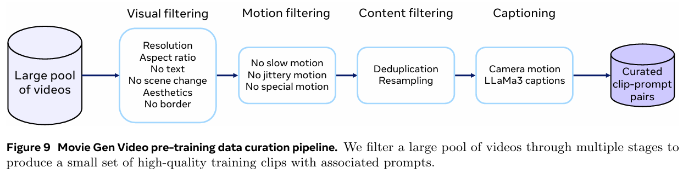
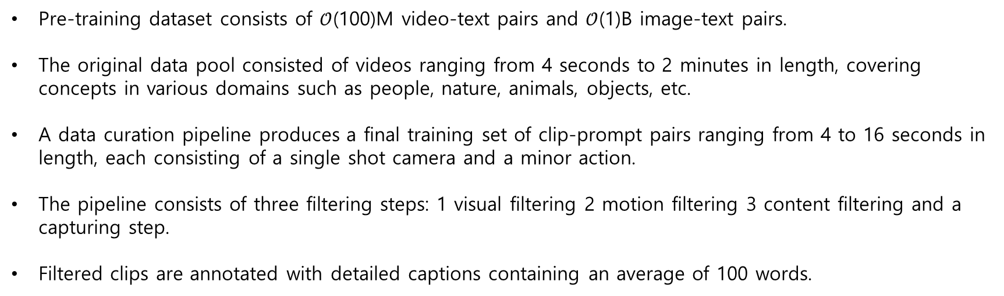
Polyak, Adam, et al. "Movie gen: A cast of media foundation models." arXiv preprint arXiv:2410.13720 (2024).
Movie Gen Video – Joint Image and Video Generation
Pre-training
Pre-training dataset consists of $𝒪$(100)M video-text pairs and $𝒪$(1)B image-text pairs.
The original data pool consisted of videos ranging from 4 seconds to 2 minutes in length, covering concepts in various domains such as people, nature, animals, objects, etc.
A data curation pipeline produces a final training set of clip-prompt pairs ranging from 4 to 16 seconds in length, each consisting of a single shot camera and a minor action.
The pipeline consists of three filtering steps: 1 visual filtering 2 motion filtering 3 content filtering and a capturing step.
Filtered clips are annotated with detailed captions containing an average of 100 words.

Slide 21
Polyak, Adam, et al. "Movie gen: A cast of media foundation models." arXiv preprint arXiv:2410.13720 (2024).
Movie Gen Video – Joint Image and Video Generation
Pre-training – Visual Filtering
Use only videos with a minimum width or height of 720px or more.
Use videos with a 60:40 aspect ratio. This is because horizontal videos provide more stable motion and longer duration.
Remove videos with excessive text using a video OCR model.
Use Ffmpeg to perform scene boundary detection to extract clips between 4 and 16 seconds in length from the video.
Filter based on visual aesthetics, image quality, large borders, and visual effects at the frame level.

Slide 22
Polyak, Adam, et al. "Movie gen: A cast of media foundation models." arXiv preprint arXiv:2410.13720 (2024).
Movie Gen Video – Joint Image and Video Generation
Pre-training – Motion Filtering
Remove motionless videos using a static video detection model
Identify videos with proper motion based on motion vectors using FFmpeg Developers
Use Shot Boundary Detection from the PySceneDetect library to remove videos with frequent camera shaking
Remove videos with special motion effects, such as slideshow videos

Slide 23
Polyak, Adam, et al. "Movie gen: A cast of media foundation models." arXiv preprint arXiv:2410.13720 (2024).
Movie Gen Video – Joint Image and Video Generation
Pre-training – Content Filtering
Remove duplicate clips from a pre-training set using similarity in copy-detection embedding space
Identify fine-grained concept clusters by clustering semantic embeddings in a video-text co-embedding model, merge duplicate clusters, and sample clips from each merged cluster according to the inverse square root of the cluster size to adjust the proportion of specific topics

Slide 24
Polyak, Adam, et al. "Movie gen: A cast of media foundation models." arXiv preprint arXiv:2410.13720 (2024).
Movie Gen Video – Joint Image and Video Generation
Pre-training – Captioning
Using the LLaMa3-Video model to generate detailed text captions for video clips.
Fine-tuned the 8B and 70B variants of the model and used it to generate captions for a full training set of video clips.
Trained a camera motion classifier to predict 16 camera motion classes (zoom out, pan left, etc.) for camera motion control.
Prefixing generated text captions with high confidence camera motion predictions.
Allows users to specify explicit camera control for video generation at inference time.

Slide 25
Polyak, Adam, et al. "Movie gen: A cast of media foundation models." arXiv preprint arXiv:2410.13720 (2024).
Movie Gen Video – Joint Image and Video Generation
Training
Using a multi-step training process to maximize efficiency and scalability.
Initial T2I training, followed by T2I and T2V co-training.
Co-training early on leads to slower learning and higher memory usage; stabilize initial weights with T2I training, then switch to co-training.
Start with a low resolution of 256px and process larger batch sizes and more data by only performing T2I tasks.
Utilize the spatial location embeddings learned from T2I training. Add new temporal location embeddings to train on video data 256px.
Scale the model trained in the 256px step to 768px resolution. Leverage weights learned in the 256px step to train at higher resolution with smaller batch sizes and more sophisticated data

Slide 26
Polyak, Adam, et al. "Movie gen: A cast of media foundation models." arXiv preprint arXiv:2410.13720 (2024).
Movie Gen Video – Joint Image and Video Generation
Fine-tuning
Pre-training produces high-quality images, but fine-tuning brings out even more quality and detail.
Built from a large pool of videos through a rigorous 4-step curation process
1. filtering videos using automatic filters - setting strict thresholds for aesthetic quality, motion, and transitions. Remove small or low-subject videos using object detection models. Select stable and visually appealing videos.
2. manually select a few visually appealing seed videos per concept. Performing k-NN based on these seed videos to generate a balanced subset of videos. In this process, we still utilize the same video-text joint embedding model we used for pre-training..
3. manually filtered by humans as it is difficult to obtain reliable videos with automatic filtering alone. Additional video clips of any length were added to complete the dataset by selecting the clips deemed best by the annotators.
4. refine the captions automatically generated by LLaMa3-Video. Include camera control, human facial expressions, background information, detailed action descriptions, lighting information, etc. and manually add information about six types of camera motion and position by annotators.
Using the same structure as the pre-training architecture. Trained with relatively small batch size (512 H100 GPUs) using pre-trained checkpoints as initialization (using cosine scheduler).
Combine the fine-tuning dataset, hyperparameters, and pre-trained checkpoints to create the final model

Slide 27
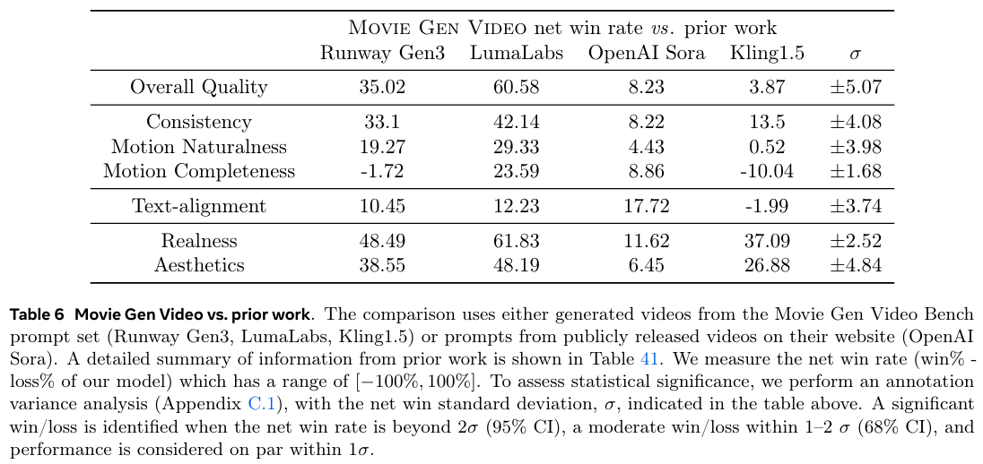
Polyak, Adam, et al. "Movie gen: A cast of media foundation models." arXiv preprint arXiv:2410.13720 (2024).
Movie Gen Video – Joint Image and Video Generation
Results
$σ$ = standard deviation $2>σ$: A significant win/loss
$1<σ≤2$: a moderate win/loss $1≤σ$ : Performance is considered

Slide 28
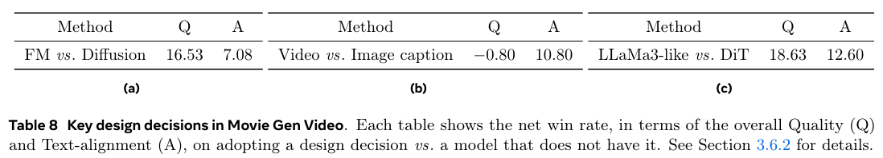
Polyak, Adam, et al. "Movie gen: A cast of media foundation models." arXiv preprint arXiv:2410.13720 (2024).
Movie Gen Video – Joint Image and Video Generation
Results

Slide 29
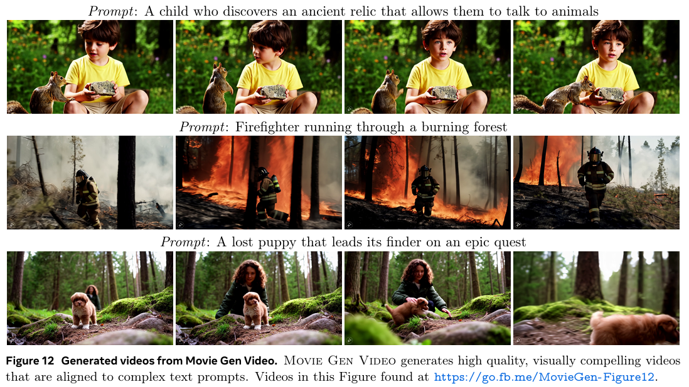
Polyak, Adam, et al. "Movie gen: A cast of media foundation models." arXiv preprint arXiv:2410.13720 (2024).
Movie Gen Video – Joint Image and Video Generation
Results

Slide 30
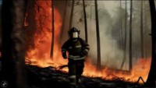
Polyak, Adam, et al. "Movie gen: A cast of media foundation models." arXiv preprint arXiv:2410.13720 (2024).
Movie Gen Video – Joint Image and Video Generation
Results
Prompt: Firefighter running through a burning forest

Slide 31
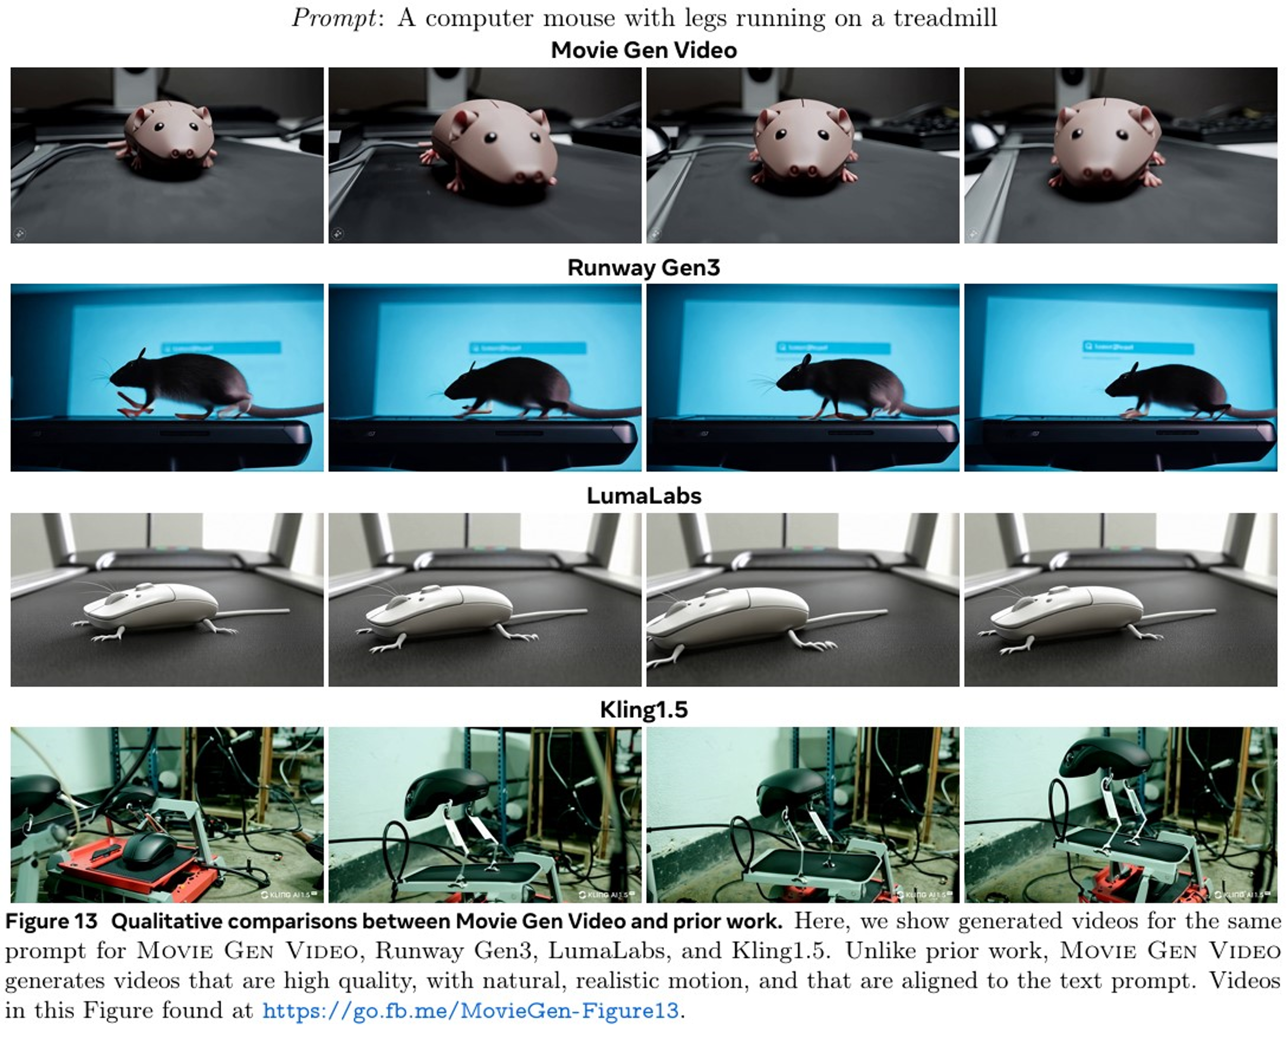
Polyak, Adam, et al. "Movie gen: A cast of media foundation models." arXiv preprint arXiv:2410.13720 (2024).
Movie Gen Video – Joint Image and Video Generation
Results

Slide 32
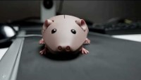
Polyak, Adam, et al. "Movie gen: A cast of media foundation models." arXiv preprint arXiv:2410.13720 (2024).
Movie Gen Video – Joint Image and Video Generation
Results
Prompt: A computer mouse with legs running on a treadmill

Slide 33
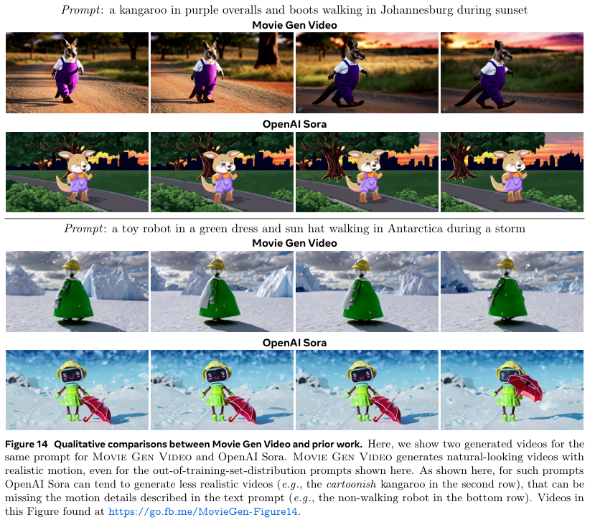
Polyak, Adam, et al. "Movie gen: A cast of media foundation models." arXiv preprint arXiv:2410.13720 (2024).
Movie Gen Video – Joint Image and Video Generation
Results

Slide 34
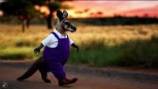
Polyak, Adam, et al. "Movie gen: A cast of media foundation models." arXiv preprint arXiv:2410.13720 (2024).
Movie Gen Video – Joint Image and Video Generation
Results
Prompt: a kangaroo in purple overalls and boots walking in Johannesburg during sunset

Slide 35
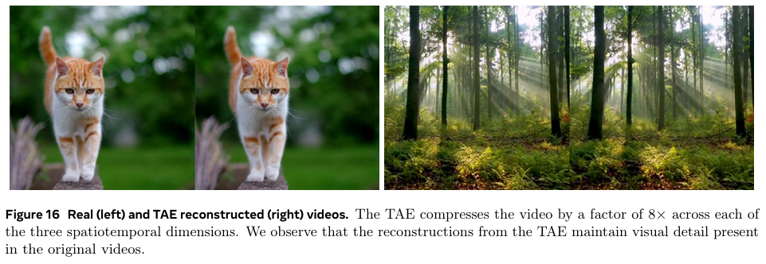
Polyak, Adam, et al. "Movie gen: A cast of media foundation models." arXiv preprint arXiv:2410.13720 (2024).
Movie Gen Video – Joint Image and Video Generation
Results

Slide 36
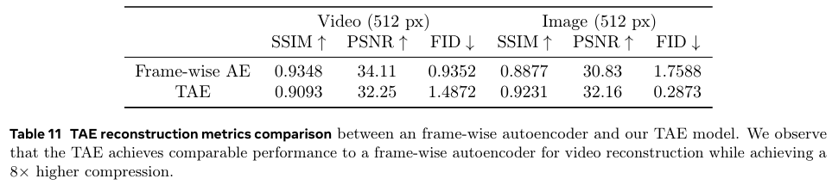
Polyak, Adam, et al. "Movie gen: A cast of media foundation models." arXiv preprint arXiv:2410.13720 (2024).
Movie Gen Video – Joint Image and Video Generation
Results

Slide 37
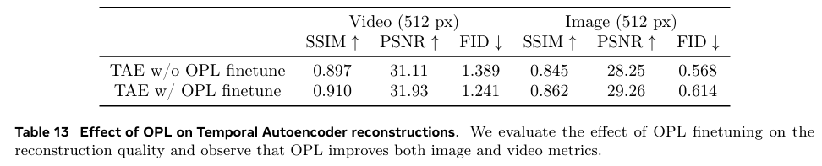
Polyak, Adam, et al. "Movie gen: A cast of media foundation models." arXiv preprint arXiv:2410.13720 (2024).
Movie Gen Video – Joint Image and Video Generation
Results

Slide 38
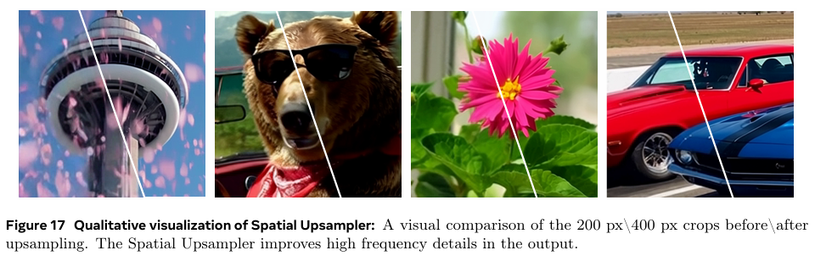
Polyak, Adam, et al. "Movie gen: A cast of media foundation models." arXiv preprint arXiv:2410.13720 (2024).
Movie Gen Video – Joint Image and Video Generation
Results

Slide 39
Polyak, Adam, et al. "Movie gen: A cast of media foundation models." arXiv preprint arXiv:2410.13720 (2024).
Video Personalization – Overview
The Personalization feature allows the video generation model to generate videos featuring the selected person based on text and a portrait image.
The generated personalized video follows the text prompts while maintaining the identity of the person.
Train the model by using a subset of videos containing people, and automatically constructing pairs of (image, text) inputs and video outputs.

Slide 40
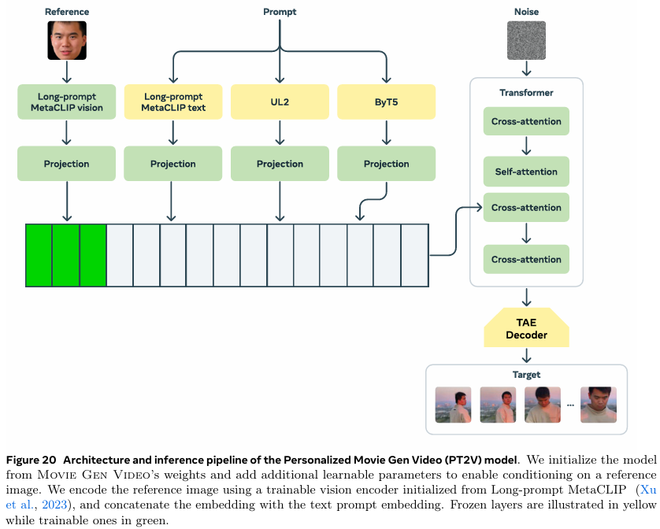
Polyak, Adam, et al. "Movie gen: A cast of media foundation models." arXiv preprint arXiv:2410.13720 (2024).
Video Personalization – Model

Slide 41
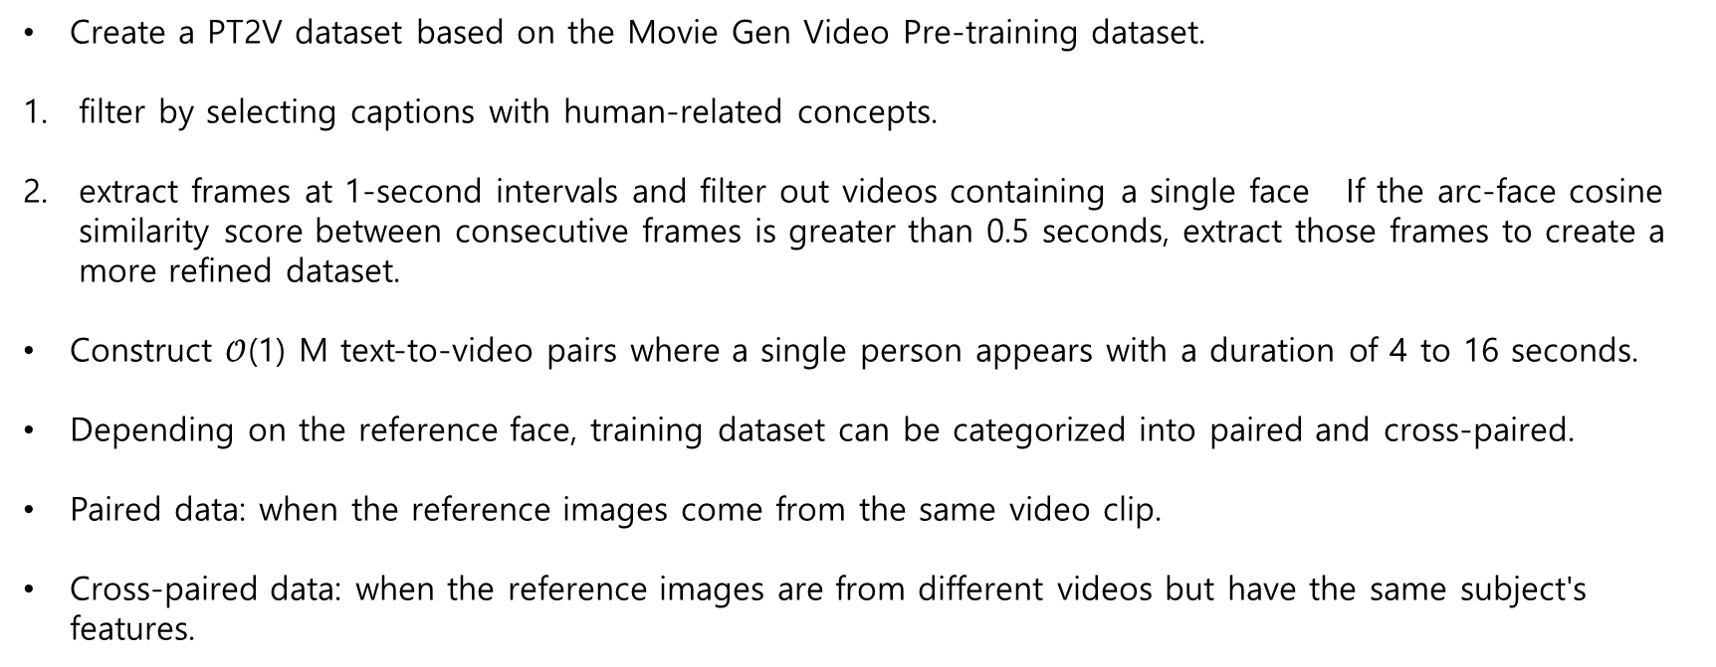
Polyak, Adam, et al. "Movie gen: A cast of media foundation models." arXiv preprint arXiv:2410.13720 (2024).
Video Personalization – Pre-training Data
Create a PT2V dataset based on the Movie Gen Video Pre-training dataset.
filter by selecting captions with human-related concepts.
extract frames at 1-second intervals and filter out videos containing a single face If the arc-face cosine similarity score between consecutive frames is greater than 0.5 seconds, extract those frames to create a more refined dataset.
Construct $𝒪$(1) M text-to-video pairs where a single person appears with a duration of 4 to 16 seconds.
Depending on the reference face, training dataset can be categorized into paired and cross-paired.
Paired data: when the reference images come from the same video clip.
Cross-paired data: when the reference images are from different videos but have the same subject's features.

Slide 42
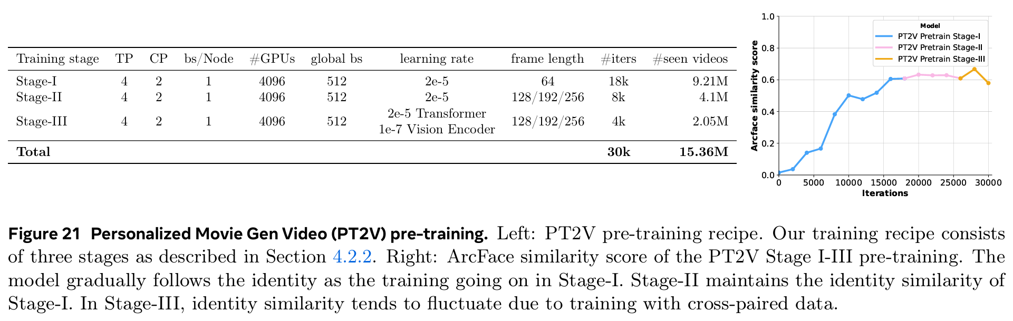
Polyak, Adam, et al. "Movie gen: A cast of media foundation models." arXiv preprint arXiv:2410.13720 (2024).
Video Personalization – Pre-training
Stage-I: Identity injection
Simplify the problem by conditioning the model on reference images and training with short videos.
Freeze the vision encoder and train only the transformer backbone.
This step allows the model to quickly learn the reference image.

Slide 43
Polyak, Adam, et al. "Movie gen: A cast of media foundation models." arXiv preprint arXiv:2410.13720 (2024).
Video Personalization – Pre-training
Stage-II: Long video generation
Continuing to train the PT2V model from stage I using a larger number of latent frames, similar to the T2V model.
Significantly improve the consistency of long video generation in terms of background and motion consistency in this stage.

Slide 44
Polyak, Adam, et al. "Movie gen: A cast of media foundation models." arXiv preprint arXiv:2410.13720 (2024).
Video Personalization – Pre-training
Stage-III: Improve naturalness
Improving the naturalness and facial expressions of the video by training on cross-paired samples where the reference image is not the corresponding target video.
Fine-tune the vision encoder in this stage to extract more detailed identity features from the reference image.

Slide 45
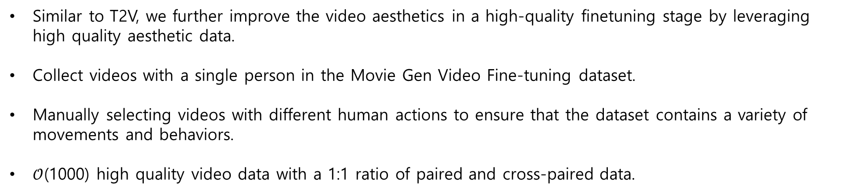
Polyak, Adam, et al. "Movie gen: A cast of media foundation models." arXiv preprint arXiv:2410.13720 (2024).
Video Personalization – Supervised Finetunign
Similar to T2V, we further improve the video aesthetics in a high-quality finetuning stage by leveraging high quality aesthetic data.
Collect videos with a single person in the Movie Gen Video Fine-tuning dataset.
Manually selecting videos with different human actions to ensure that the dataset contains a variety of movements and behaviors.
$𝒪$(1000) high quality video data with a 1:1 ratio of paired and cross-paired data.

Slide 46
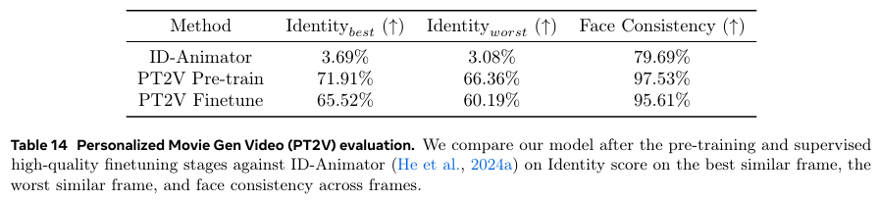
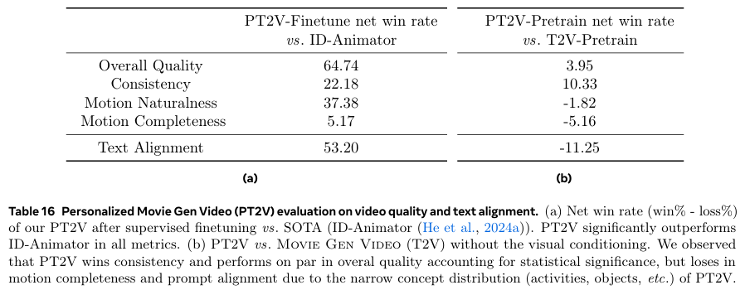
Polyak, Adam, et al. "Movie gen: A cast of media foundation models." arXiv preprint arXiv:2410.13720 (2024).
Video Personalization – Results

Slide 47
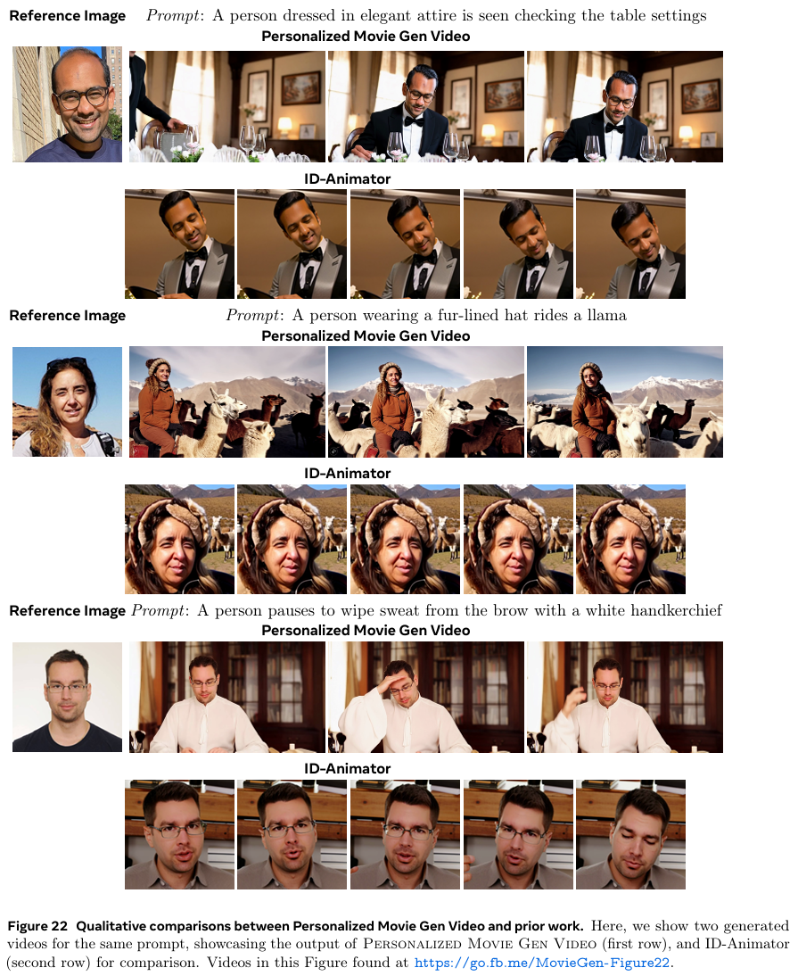
Polyak, Adam, et al. "Movie gen: A cast of media foundation models." arXiv preprint arXiv:2410.13720 (2024).
Video Personalization – Results

Slide 48
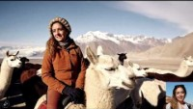
Polyak, Adam, et al. "Movie gen: A cast of media foundation models." arXiv preprint arXiv:2410.13720 (2024).
Video Personalization – Results
Prompt: A person wearing a fur-lined hat rides a llama

Slide 49
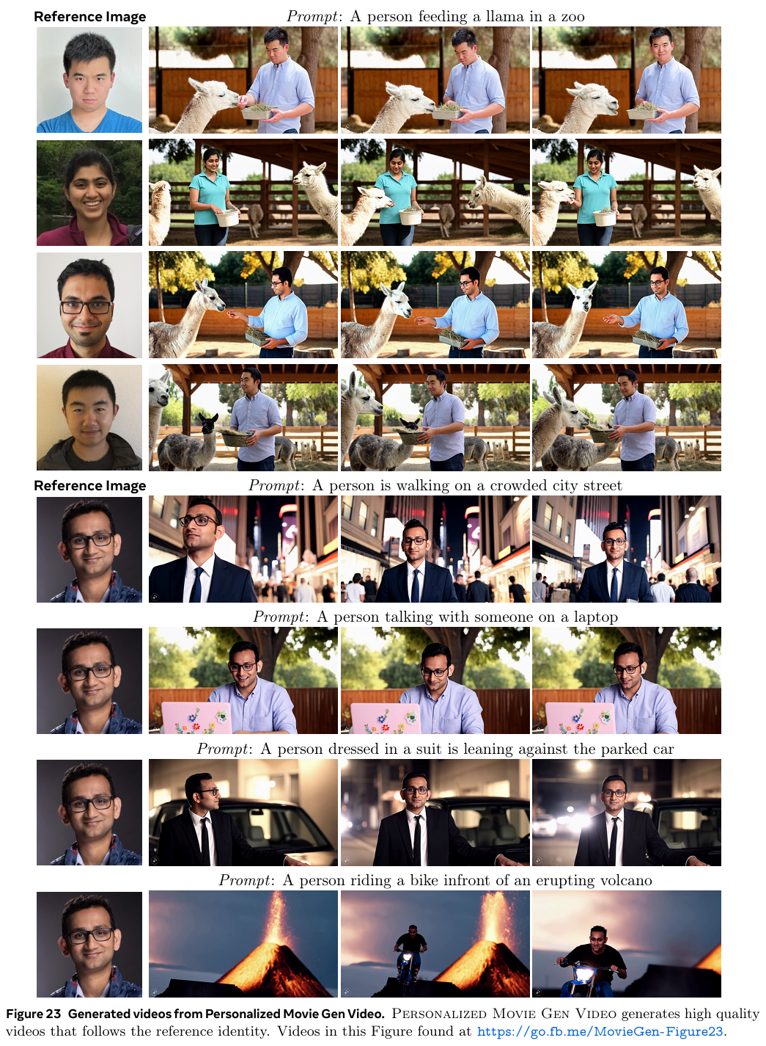
Polyak, Adam, et al. "Movie gen: A cast of media foundation models." arXiv preprint arXiv:2410.13720 (2024).
Video Personalization – Results

Slide 50
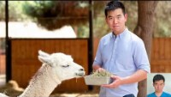
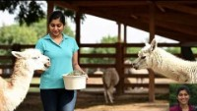
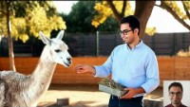
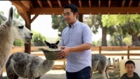
Polyak, Adam, et al. "Movie gen: A cast of media foundation models." arXiv preprint arXiv:2410.13720 (2024).
Video Personalization – Results
Prompt: A person feeding a llama in a zoo

Slide 51
Thank you!

